Slide 1
Shopping Website
Powered by html/css+php

Slide 2
1. Home Page
Newly posted
Searching
Quickview
About account

Slide 3
2. New Product
Site Navigator
Add to Cart
Comment and rating

Slide 4
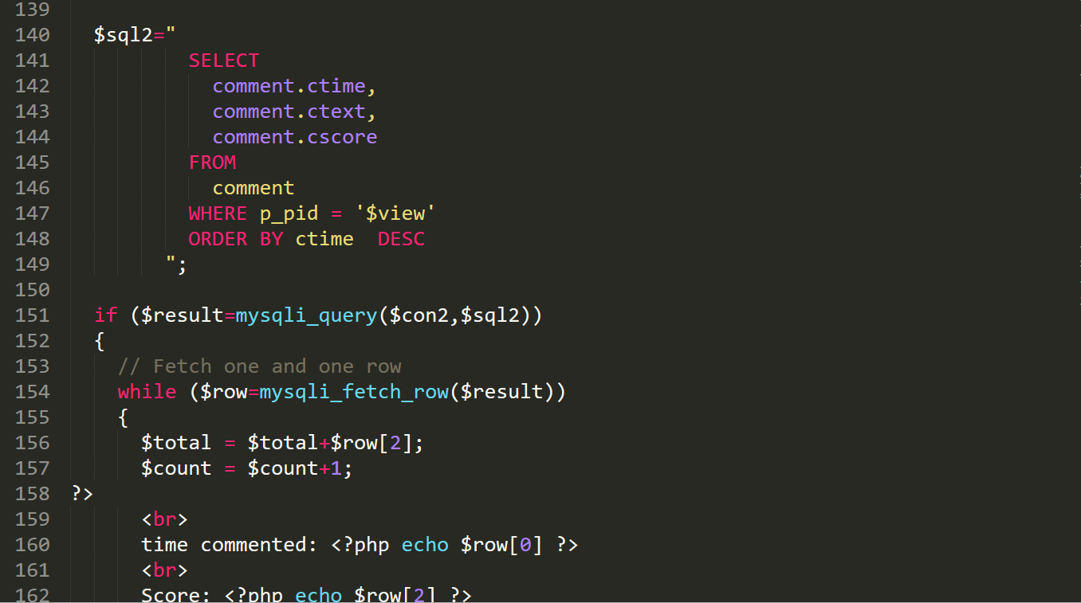
Comment

Slide 5
3. Database
Table “list”

Slide 6
4. Sell
Nothing special

Slide 7
5. Kart
Overview
Empty Shopping Cart
Place Order

Slide 8
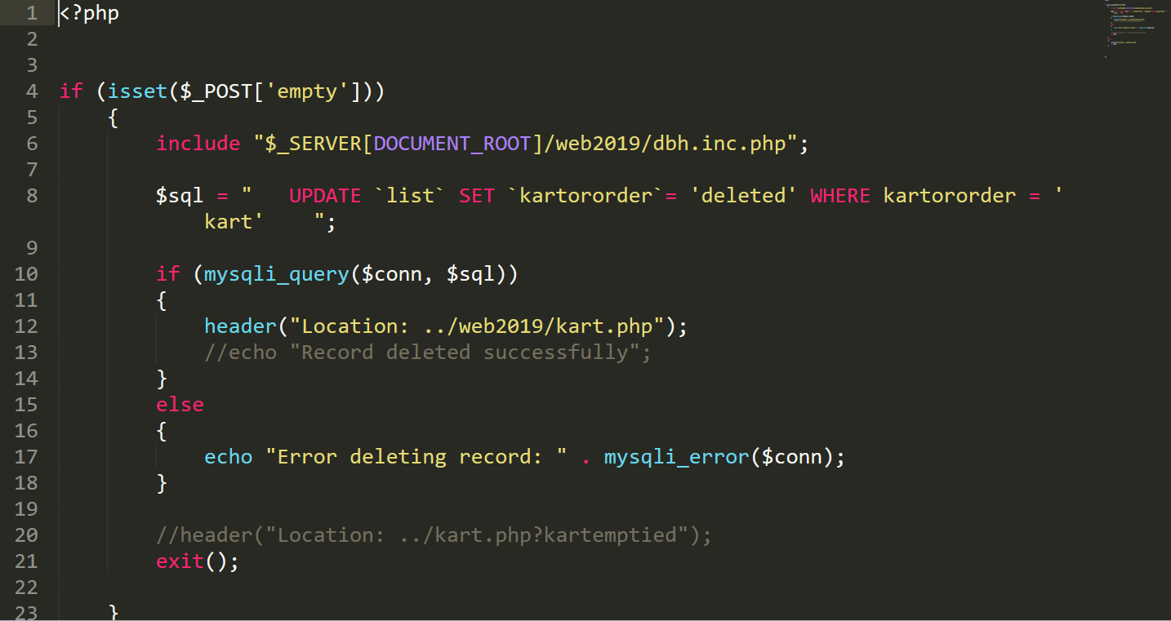
Empty shopping cart

Slide 9
6. My Order
Order Information
Leaving Comment
Rating

Slide 10
7. Payment
https://developer.paypal.com/docs/checkout/#how-the-buttons-work
https://justcoded.com/blog/how-to-integrate-a-payment-gateway-into-a-website/

Slide 11
Payment
1. Paypal customize button
2. Paypal API
3. Other services

Slide 12
Thank You

